Slide 1
William L Wilcox m. Josephine Wetmore 14 Feb. 1860
How do we know what we know? And how sure are we about it?

Slide 2
Starting with a family bible

Slide 4
Births

Slide 5
Marriages

Slide 6
Searching Ancestry brought up a record in this database

Slide 7
Learn more about a database by scrolling down…
REMEMBER: Cite Your Sources – Where did I get this information?
And learn about the source.

Slide 8
Marriage reported in newspaper

Slide 9
View image: But this is not the newspaper record

Slide 10
It is an index/abstract from the New Haven Columbian Register

Slide 11
View Image: What the entry tells us
Name Residence At SLN 123 Date of mar
This is date of newspaper
???????

Slide 12
Does it matter what that heading meant? There isn’t anything in the column .
Probably not.
You never know.
Good habit for effective research: check front for preface, explanatory information, background information, lists of abbreviations etc.
Whether material is in a book or on film or digital

Slide 13
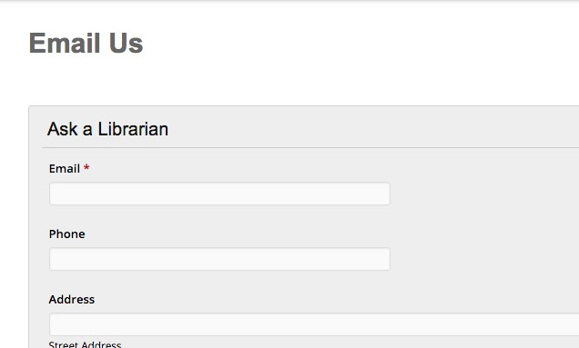
When in doubt, ask a librarian!

Slide 14
Can we find a copy of the New Haven Columbian Register online?
Google: New Haven Columbian digital
AncestorHunt Newspapers: Connecticut list
Includes links to pages listing newspapers in subscription databases
GenealogyBank.com (subscription site)
How much does it cost? How do I decide if it is worth it to me?

Slide 15
I had a subscription, but this was not easy to find. OCR problems abound.
No other information and all information correct in the abstract.

Slide 16
Deaths
This tells us William Wilcox
Died

Slide 17
Did he die in 1873 (Bible Record) or 1872 (FindAGrave)

Slide 18
The stone clearly says 1872

Slide 19
What will help us resolve this?
Death Record -
Probate Record
Newspaper notice of his death (or better, an obituary)
Church records
Where will these records most likely be found?

Slide 20
In 1870 the family is in Middletown, Middlesex Co., Connecticut
He owned both real and personal property, so almost certainly a probate record exists.

Slide 21
But no Middlesex Co. Ct. death records filmed. Why not?
Did you read the FamilySearch Wiki about vital records in Connecticut??

Slide 22
Middletown death records appear to be filmed.

Slide 23
Use the side control to browse through the whole
You can see where one item ends and another begins (the black boxes)

Slide 24
Vol. 3 and 4 appear to have only marriages and births
Notice that when a page is selected you learn the image # of that page.
A selected page… click to open it up

Slide 25
Couldn’t find death record
Remember: I work very quickly for class work and you can’t trust my finding! Do more with this. But let’s say we just can’t get at a death record.
Death Record -
Probate Record - have they been filmed, online?
Newspaper notice of his death (or better, an obituary)
Church records

Slide 26
I cheated and found news of his death in GenealogyBank.
Subscription databases can be worth the money as long as you spend carefully.
4 children?

Slide 27
Enticements…but be careful! Cancel by deadline; be sure it went through.

Slide 28
Wait a minute…. What was the question??
Preliminary gathering of information doesn’t require a question.
Search or research?
Standard steps
Gather vital records: birth, marriage, death
Gather census records for every census
Find commonly used sources: cemetery, land, probate etc.

